Slide 1
Decision Making: Decision Trees, Behavior Trees, Rule-Based Systems
Based on Artificial Intelligence for Games by Millington, Funge

Slide 2
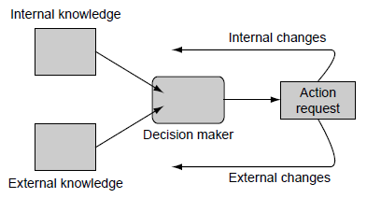
Decision Making: Input
Input: knowledge that a character possesses
Internal
Information about the character’s internal state or thought processes:
Its health,
its ultimate goals,
what it was doing a couple of seconds ago, etc.
External
External knowledge is the information that a character knows about the game environment around them:
the position of other characters,
the layout of the level,
whether a switch has been thrown,
the direction that a noise is coming from, and so on.

Slide 3
Decision Making: Output
Output: action request.
Change the external state of the character
throwing a switch,
firing a weapon,
moving into a room, etc.
Change the internal state of the character
Less obvious in game
Significant in some decision making algorithms
Examples:
Changing the character’s opinion of the player,
changing its emotional state, or
changing its ultimate goal

Slide 4
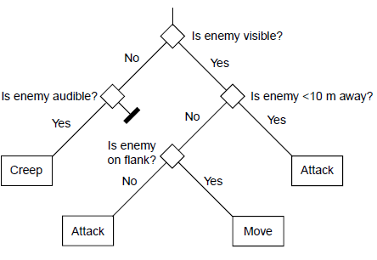
Decision Trees
Decision trees are popular in machine learning:
Relatively easy to learn,
Simple
Efficient execution (for a balanced tree)
Typically created using supervised learning techniques (ID3, C4.5)
Use as a classifier
Representation:
Each non-leaf node is a decision (not always binary).
Each leaf is an action.
In games, decision trees are simple to model and can thus be created by designers (non-programmers).

Slide 5
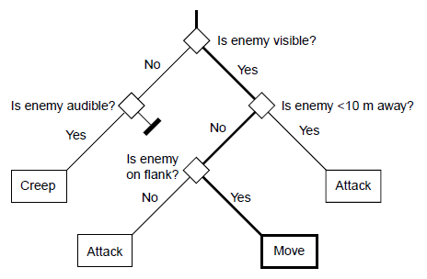
Decision Trees: Path
A path corresponds to an action that was 'decided upon' based on the current information.

Slide 6
Decision Types
Depending on implementation and data types of the values stored as character knowledge, different kinds of tests (decisions) may be possible. A representative set:
Datatype | Decision
Boolean | True path
Enumeration | Matching discrete value
Numeric (int or float) | When within range
Vector | Length is within range (e.g., distance between character and NPC, etc.)
Delegate Functions | Complex behavior distilled to one of the above types.

Slide 7
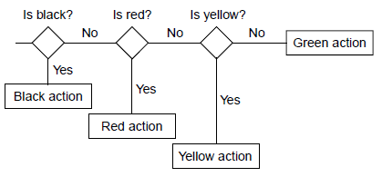
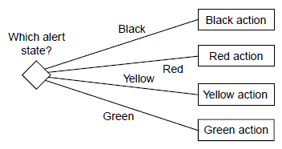
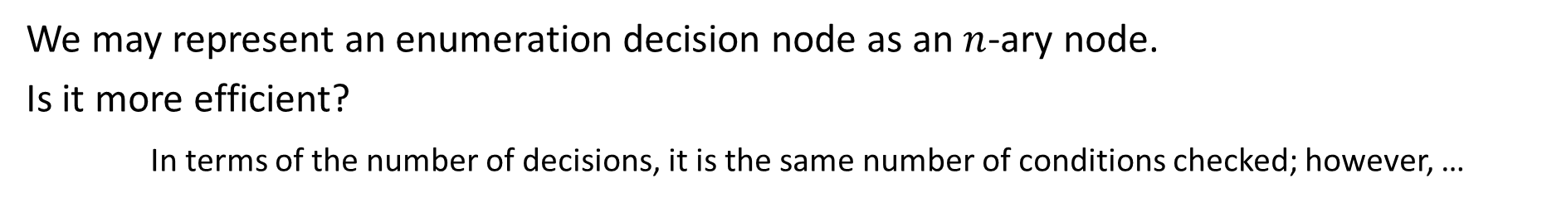
Deep vs. Flat Decision Trees
We may represent an enumeration decision node as an $n$-ary node.
Is it more efficient?
In terms of the number of decisions, it is the same number of conditions checked; however, …
The same alert state value will be acquired and checked three times in the binary tree.
Not much of a problem if we order the checks so that high probability values come first.
We should avoid repeating the alert state check (especially in a multi-threaded environment).
However, most implementations of decision trees are binary.

Slide 8
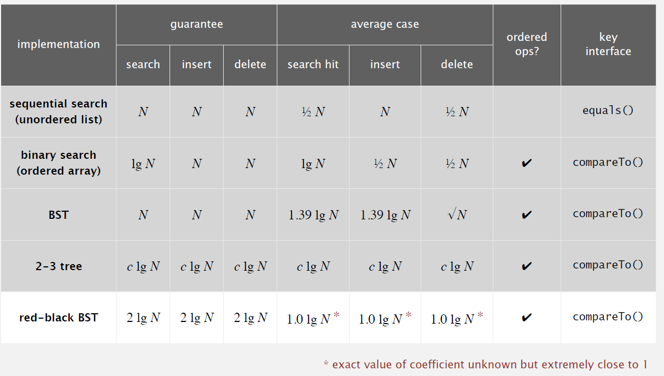
Binary Search Trees Performance Summary
credit

Slide 9
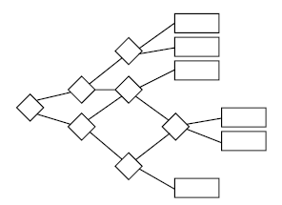
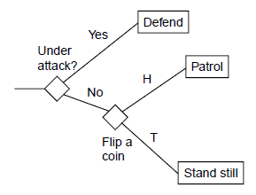
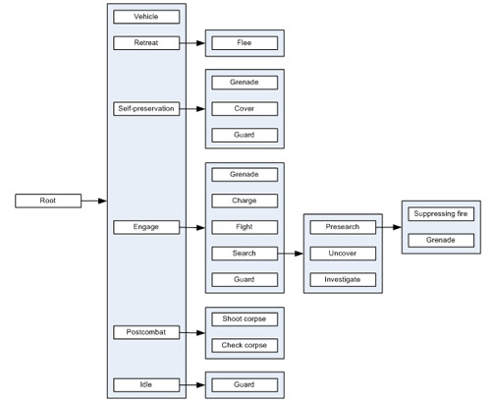
Other Decisions and Structures
Random Decisions
DAGs
Halo 2 DAG

Slide 10
Behavior Trees
First introduced in Halo 2 (2004)
Synthesis of a number of techniques
FSM
Decision Trees

Slide 11
Behavior Tree Nodes
Conditional
Test some property of game: Proximity, line of sight, state of character, etc.
Like an if statement: remaining actions are not carried out if it fails
Action
Alter state of game
Animation, character movement, change of internal state, audio, etc.
Composite
Interior nodes of the tree
Two Main Types (Will Discuss Decorators Later):
Selectors: returns immediately if one of its children runs successfully
Sequence: returns failure immediately if one of its children returns unsuccessfully

Slide 12
Behavior Tree: Selector Node
Selector nodes are indicated with a question mark:
Choose the first of a set of possible actions that is successful.
?
Attack
Taunt
Stare

Slide 13
Behavior Tree: Sequence Node
Sequence nodes are indicated with a forward arrow (→):
return failure when one child fails (all must run successfully in sequence).
→
Enemy Visible?
Turn Away
Run Away

Slide 14
Behavior Tree Example
Enter a room opening a door if necessary.
?
→
→
Door Open?
Move into the Room
Move to Door
Open Door
Move into the Room

Slide 15
Behavior Tree Example (Refactored)
Enter a room opening a door if necessary.
→
?
Move into the Room
Door Open?
→
Move to Door
Open Door

Slide 16
Behavior Tree Example (Version 2)
Enter a room opening a door if necessary. What if the door is locked?
?
→
→
Door Open?
Move into the Room
Move to Door
?
Move into the Room
→
→
Alternating levels of selector and sequence nodes implements reactive planning: avatars check conditions and base actions on those checks.
Door Not Locked?
Open Door
Door Locked?
Barge Door

Slide 17
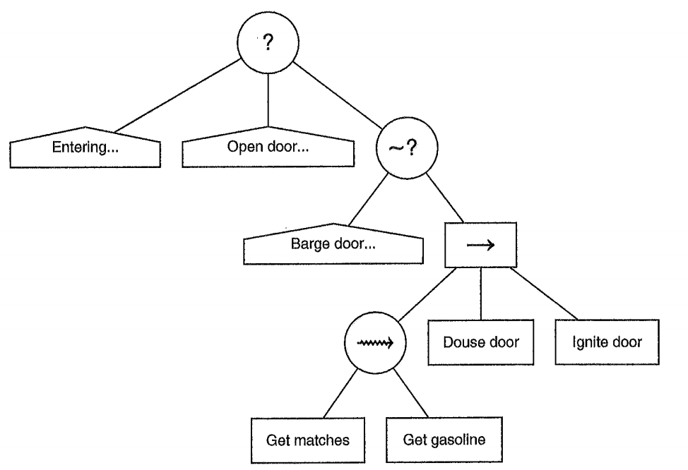
Behavior Trees: Randomization
Evaluation is typically using a left-to-right traversal.
(Note: we are not guaranteed a complete traversal due to a child of a selector succeeding or a child of a sequence node failing.)
Can implement random behavior by evaluating in a different order: shuffle.
Non-Deterministic Nodes

Slide 18
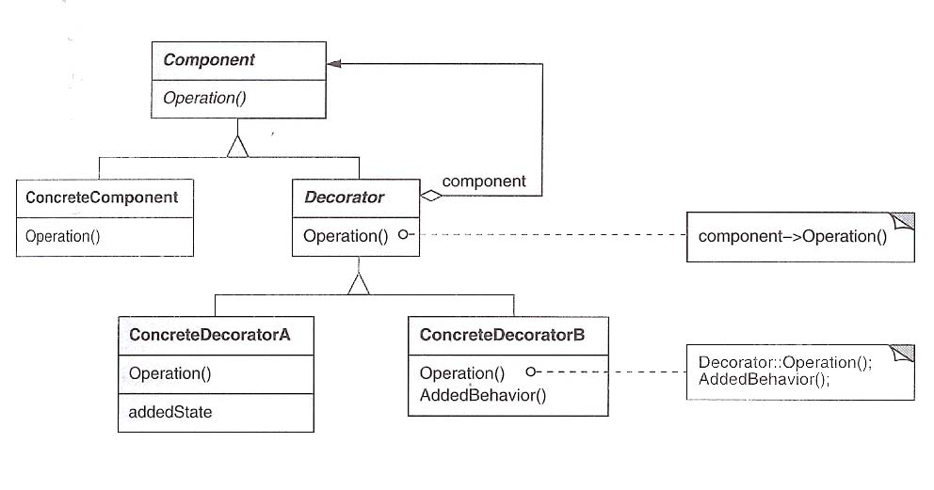
Decorator Design Pattern (aka Wrapper)
Allows behavior to be added to an individual object, dynamically, without affecting the behavior of other objects from the same class.
A decorator is more flexible than the inheritance alternative
Responsibilities can be added and detached in run-time
Retains the ability to add functionality incrementally from simple pieces
Do not need to know all foreseeable features of the class before it is built

Slide 19
Behavior Trees: Decorators
Many types of decorators with behavior trees; some examples:
Limit the number of tries
E.g.: Do not try to force open a door too often
Running a task until it fails
Guarding resources when they are limited
A character can have only one animation at a time
→
Animation Available?
Animation Engine Available?
Play Animation
Play Animation
With Conditional Node
Conditional Decorator

Slide 20
Decorator Example: Until Fail
?
→
?
Visible?
Until Fail
Restrain
→
Move
→
Audible?
Creep
Conscious?
Hit
Pause
Hit

Slide 21
Parallel Decorator
Behavior (sub-)trees may need to run concurrently
Use a new composite task: Parallel
Implement with threads
Achieve process synchronization with semaphores
OS-defined (POSIX), Language-library defined (.NET)
Define a policy for parallel composite node
Sequencer Policy
Return failure as soon as a child returns with failure
Return success when all children succeed
Selector Policy
Returns when its first child succeeds
Return failure when all children fail
Hybrid
Returns success when a number (or proportion) of children succeed

Slide 22
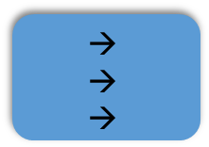
Parallel Composite Example
We may want an ally AI character to manipulate a computer bank to open a door.
$$\begin{matrix}→ \\ → \\ →\end{matrix}$$
→
Player Guarding Door?
Use Computer
Until Fails
Use Computer
Enforcing a (one-time) Condition using a Sequencer
Player Guarding Door?
This tree would allow the player to satisfy the condition and then leave the door once the NPC uses the computer.
Enforcing a (Consistently Updated) Condition using Parallel
A proper solution would include an interruption mechanism (interrupter decorator).

Slide 23
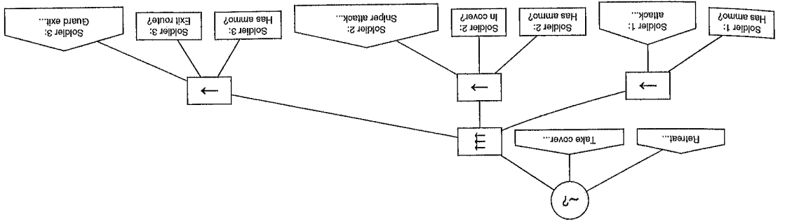
Parallel to Implement Group Behavior
At a higher level, we can control a group with parallel.
However, each member has her own behavior tree for its individual actions (shooting, taking cover, reloading, animating, playing audio, etc.)
If a team member cannot participate in their role in the strategy, then the parallel node fails and another option is selected.

Slide 24
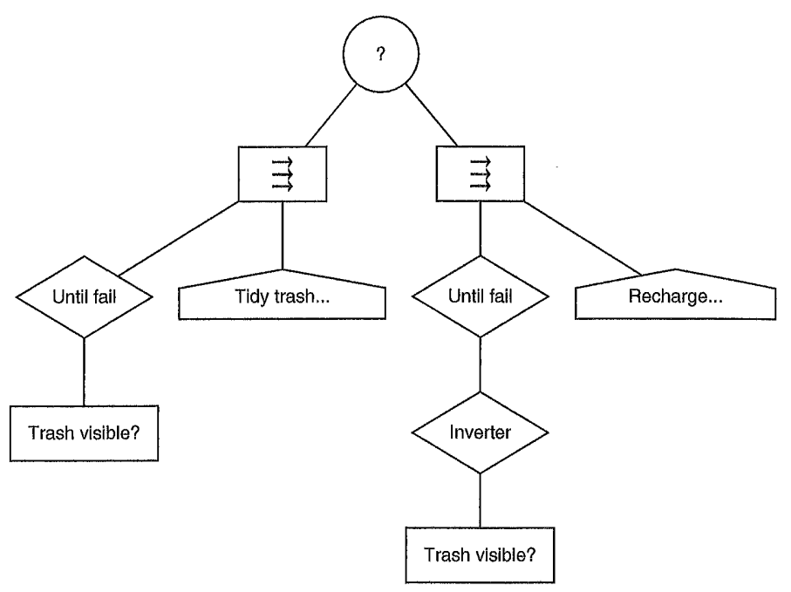
A Finite State Machine as Behavior Tree
A two-mode janitor robot.
Negation
Tidy up mode
Recharge mode

Slide 25
Rule-Based Systems
Popular AI techniques in 1970s and 1980s
Used for expert systems (emulate decision-making ability of a human expert)
Often considered too heavy for gaming
Provides a character an ability to reason about a world that cannot easily be anticipated by the designer and encoded in a decision tree.

Slide 26
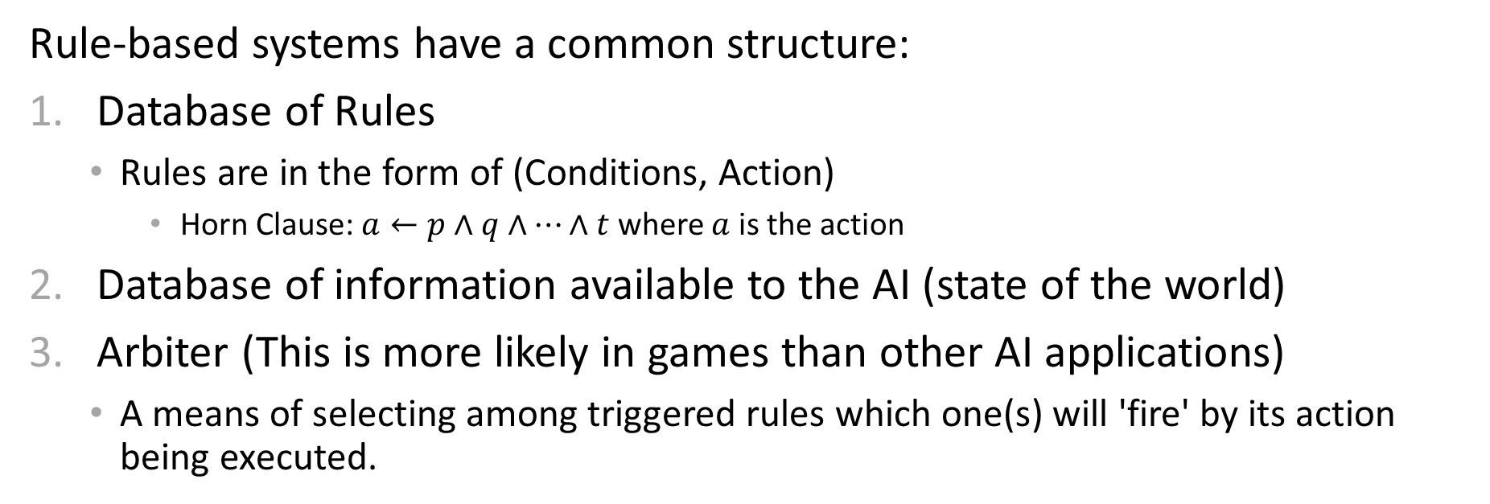
Rule-Based Systems
Rule-based systems have a common structure:
Database of Rules
Rules are in the form of (Conditions, Action)
Horn Clause: $a←p∧q∧…∧t$ where $a$ is the action
Database of information available to the AI (state of the world)
Arbiter (This is more likely in games than other AI applications)
A means of selecting among triggered rules which one(s) will 'fire' by its action being executed.
Each iteration:
Update world state,
Collect triggered rules (rules that have had their conditions met)

Slide 27
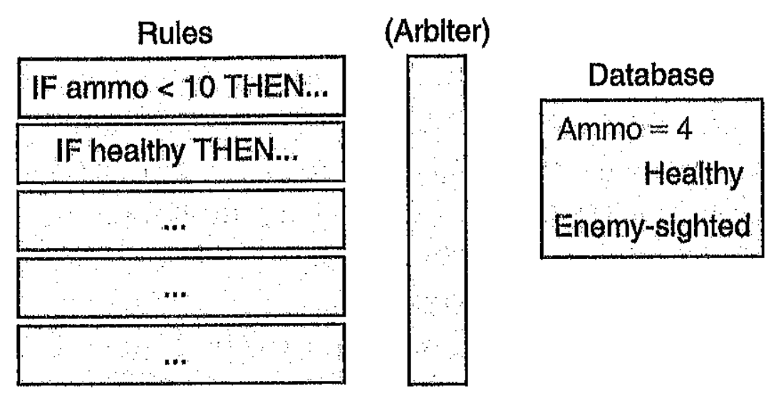
Rule-Based Systems
Database Rules should be flexible (use
'wildcards'):
if <character>.health < 15 then <character>.take-cover()
Database matching
Which rules satisfy conditions
Triggered actions may add or remove information from the world database
Actions change world database entries indirectly (although the action may not succeed)
Forward-Chaining:
Continue to iterate over deduced data until a goal is reached (a triggered action is determined) or no more information can be deduced

Slide 28
Rule Arbitration
Several rules may trigger at the same time, but only one can fire
Use heuristics to decide on order:
First applicable
Possible that the same rule then applies and fires all the time
Need to suspend rule after firing
Least Recently Used
Maintain all rules in an ordered queue
Pop and enqueue fired rule
Most Specific Condition
Rationale: Rules that have a complicated condition fire rarely, but are most specific to situation
Dynamic Priority Allocation
Each rule returns how important it may be in the moment
(e.g., "no more health packs → find health packs" is low priority when health is high)

